Slide 1
Fate and Behaviour of oil in the marine and shoreline environment
CGPRT(W) : Ensuring Clean Seas and Coasts in Western Region ……

Slide 2
Objective
To know the main processes affecting oil spilled in the marine and shoreline environment.
To recognize the importance of these processes on response techniques.
CGPRT(W) : Ensuring Clean Seas and Coasts in Western Region ……

Slide 3
Oil Behaviour
Physical and chemical processes will change oil properties and behaviour once spilled into the environment.
These processes are referred to as “oil weathering”.
Oil weathering will influence the selection of appropriate response strategies, affect operations and oil toxicity.
Oil weathering is influenced by important oil properties.
CGPRT(W) : Ensuring Clean Seas and Coasts in Western Region ……

Slide 4
Important Oil Properties
Specific gravity/ºAPI:
  density
Viscosity:
  resistance to flow
Pour point:
  temperature below which oil does not flow
CGPRT(W) : Ensuring Clean Seas and Coasts in Western Region ……

Slide 5
Important Oil Properties
Volatility:
  propensity to evaporate
Flash point:
  temperature at which vapour will ignite
Asphaltene content:
  propensity to emulsify
CGPRT(W) : Ensuring Clean Seas and Coasts in Western Region ……

Slide 6
Fate and Behaviour of Spilled Oil
Major processes:
Drifting
Spreading
Evaporation
Emulsification
Dispersion
Biodegradation
Dissolution
Photo-oxidation
Sedimentation
Shoreline interaction
CGPRT(W) : Ensuring Clean Seas and Coasts in Western Region ……

Slide 7
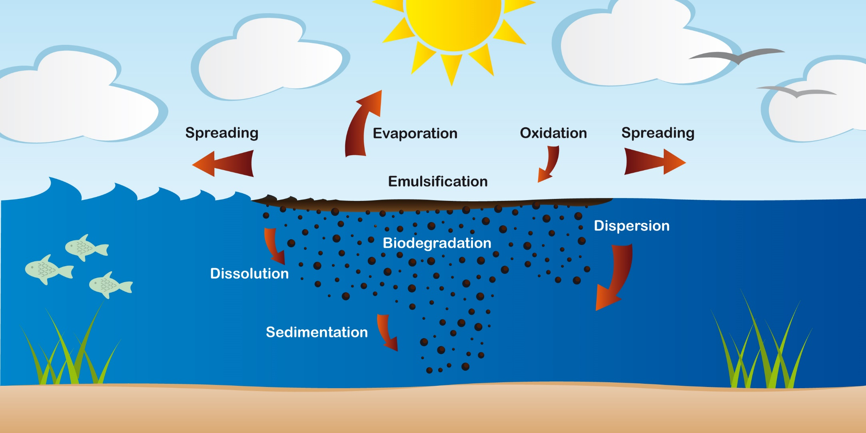
Weathering Processes
CGPRT(W) : Ensuring Clean Seas and Coasts in Western Region ……

Slide 8
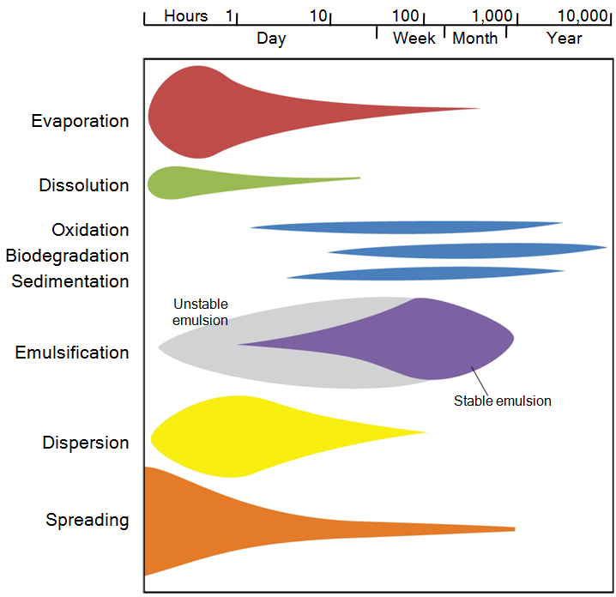
Weathering Processes Over Time
CGPRT(W) : Ensuring Clean Seas and Coasts in Western Region ……

Slide 9
Spreading
Oil will spread and fragment on the sea surface occupying a larger area.
Thickness of the oil layer on the sea surface will decrease over time, except in cases where the oil emulsifies.
This process affects oil recovery rates as:
  Thin oil layer is difficult to recover
  Lower encounter rate as oiled area is increasing.
CGPRT(W) : Ensuring Clean Seas and Coasts in Western Region ……

Slide 10
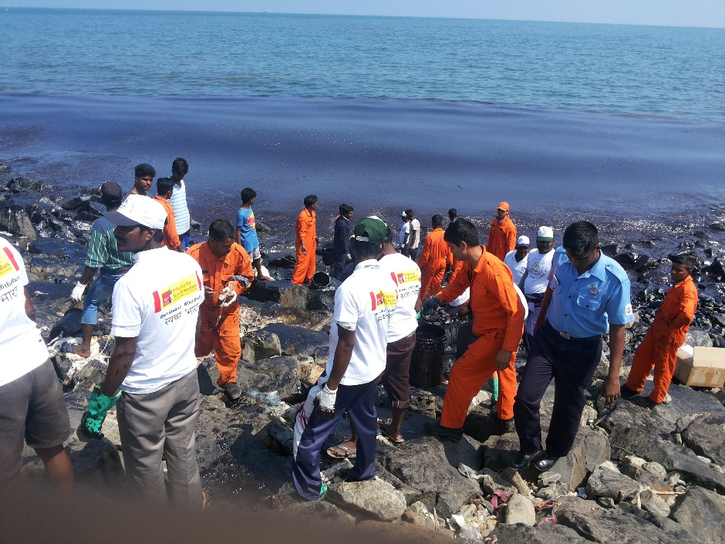
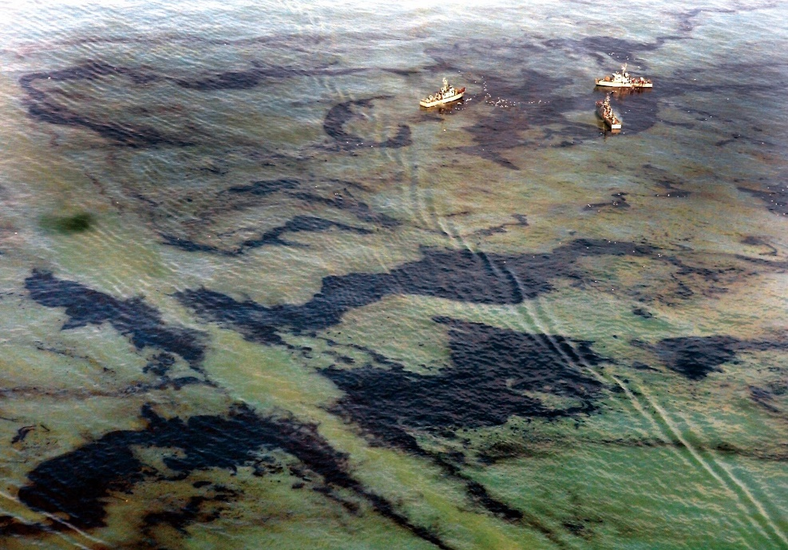
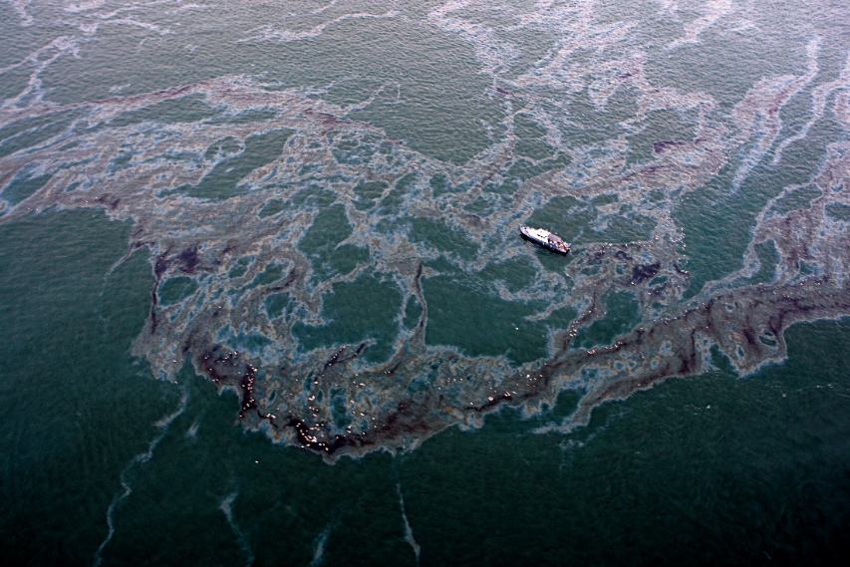
Spreading
CGPRT(W) : Ensuring Clean Seas and Coasts in Western Region ……

Slide 11
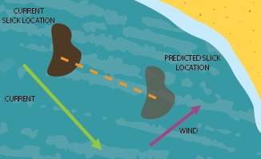
Drifting at Sea
Oil will drift at sea under the influence of currents and winds
100% current direction and speed, approximately 3% wind direction and speed
Source: OSRL
CGPRT(W) : Ensuring Clean Seas and Coasts in Western Region ……

Slide 12
Wind Effects
Wind
Wind
Wind
CGPRT(W) : Ensuring Clean Seas and Coasts in Western Region ……

Slide 13
Evaporation
Oil will release vapours in the atmosphere.
Rate of emission will depend on ambient temperature, vapour pressure and concentration of volatile components.
Vapours are generally flammable and toxic (health and safety issue).
Evaporation will contribute to reducing the volume of oil but will increase oil viscosity.
CGPRT(W) : Ensuring Clean Seas and Coasts in Western Region ……

Slide 14
Natural Dispersion
Oil droplets will be naturally entrained in the water column by wave action breaking the oil slick in small droplets.
Small droplets have the propensity to remain in suspension in the water column, facilitating dilution and biodegradation.
  Larger droplets will resurface to reform an oil slick.
Chemical dispersion using dispersants will enhance natural dispersion by promoting the formation of small droplets.
CGPRT(W) : Ensuring Clean Seas and Coasts in Western Region ……

Slide 15
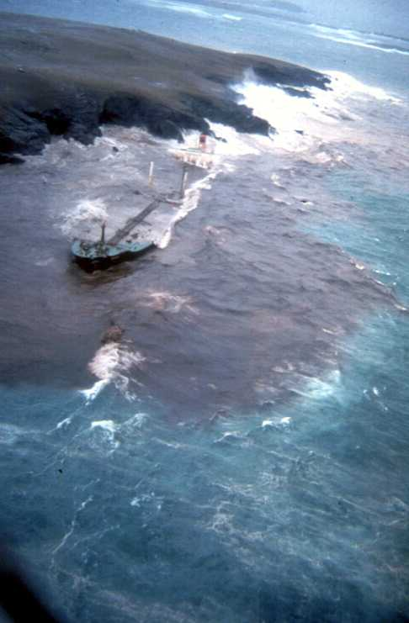
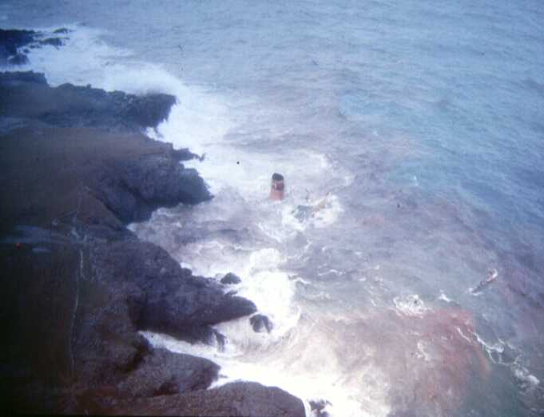
Natural Dispersion
CGPRT(W) : Ensuring Clean Seas and Coasts in Western Region ……

Slide 16
Emulsification
Water droplets can be incorporated into the oil layer by wave action forming an emulsion.
  Can be stable or unstable
Asphaltene content is a good indication of an oil propensity to form stable emulsion (above 0.5%)
A major disadvantage for response:
  Increase oil viscosity
  Increase volume
CGPRT(W) : Ensuring Clean Seas and Coasts in Western Region ……

Slide 17
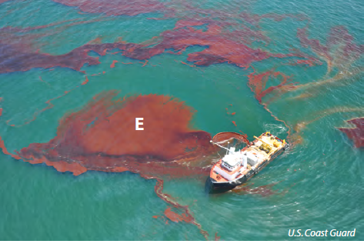
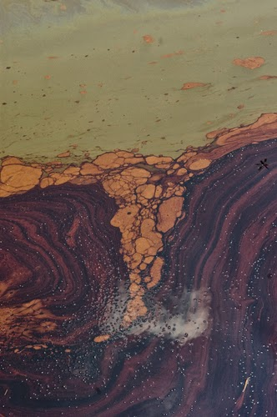
Emulsion
CGPRT(W) : Ensuring Clean Seas and Coasts in Western Region ……

Slide 18
Effects of Oil Weathering on Response
Safety
  Evaporation
Efficacy of response strategies
  Containment (e.g. spreading)
  In Situ Burning (e.g. losing ignitability by emulsification)
  Dispersants
  Skimmers
  Pumps
CGPRT(W) : Ensuring Clean Seas and Coasts in Western Region ……

Slide 19
Shoreline Interactions
In most cases, oil slicks will reach the coast.
Oil can become stranded on the shoreline.
This process will be affected by shoreline wave exposure and by the type of substrate.
CGPRT(W) : Ensuring Clean Seas and Coasts in Western Region ……

Slide 20
Shoreline Interactions
In general, we observe the following oil behaviour on shorelines:
Sand beaches
  Oil will generally remain on the surface with minimal penetration
  Oil can be buried in layers by erosion and sand movements due to wind, waves or tides.
  Oil can mix with sand particles and sink in the near shore environment or in the intertidal zone.
  Oil can mix with fine mineral particles in the intertidal zone forming small aggregates which will eventually be dispersed.
CGPRT(W) : Ensuring Clean Seas and Coasts in Western Region ……

Slide 21
Shoreline Interactions
Pebbles and cobbles beaches
  Oil will generally stick to surface of sediments.
  Oil can penetrate into interstices between sediment material.
    Generally, low viscosity oils can penetrate deeper into sediments than heavy oils.
  Clean-up can be difficult due to penetration.
CGPRT(W) : Ensuring Clean Seas and Coasts in Western Region ……

Slide 22
Shoreline Interactions
Mud flats and marshes
  Generally, oil penetration is not observed as these sediments are very compact and often flooded.
    Walking or heavy equipment can push oil into the sediments.
    Oil can penetrate into muddy shorelines via animals burrows.
  Oil can stick to vegetation.
CGPRT(W) : Ensuring Clean Seas and Coasts in Western Region ……

Slide 23
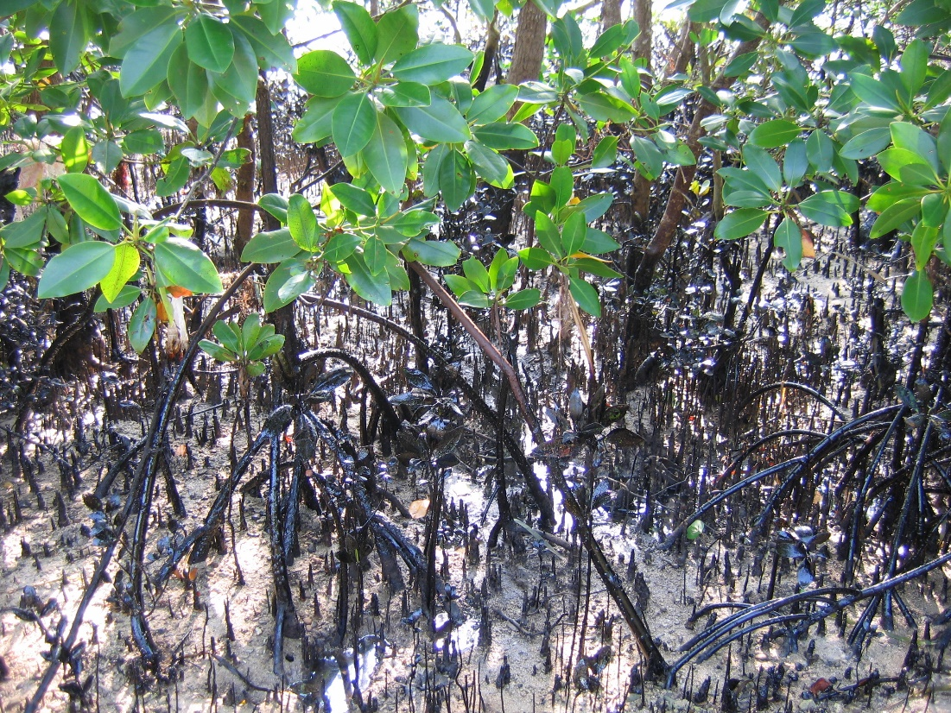
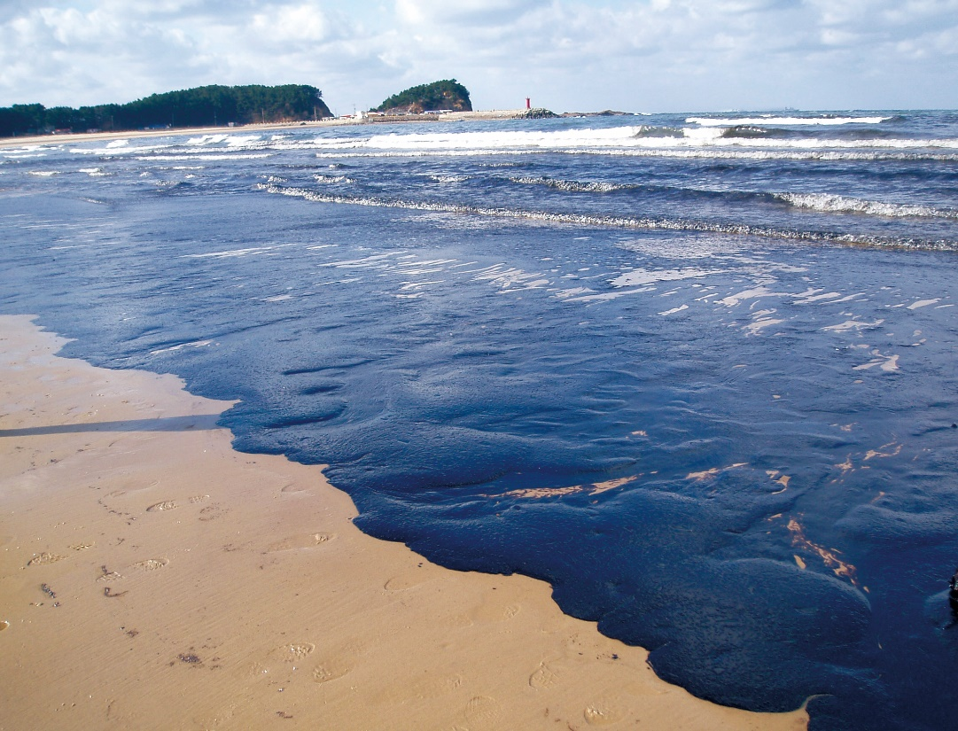
Shoreline Interactions
CGPRT(W) : Ensuring Clean Seas and Coasts in Western Region ……

Slide 24
Subsea Releases
Subsea releases can occur from sunken vessels or from a well blowout
Oil will rise to the surface forming a surface oil slick that will be exposed to normal oil weathering processes
  Oil can resurface far from the spill source due to horizontal currents, density stratification and vertical turbulence mixing
Smaller oil droplets can remain in the water column, be dispersed under the influence of subsea currents, and be subject to biodegradation
CGPRT(W) : Ensuring Clean Seas and Coasts in Western Region ……

Slide 25
Conclusion
Weathering processes will change oil properties over time.
This will have a direct impact on safety and operations.
Response decisions must consider the effect of oil weathering of efficiency of response.
CGPRT(W) : Ensuring Clean Seas and Coasts in Western Region ……

Slide 26
Any questions?
CGPRT(W) : Ensuring Clean Seas and Coasts in Western Region ……

